Slide 1
Digital Portfolio
STUDENT NAME: I. Yashar
REGISTER NO AND NMID: 24CA16 AND FC62F7BA9E79791A66E41FD86B64C70E
DEPARTMENT: BCA
COLLEGE: COLLEGE/ UNIVERSITY : Thiruvalluvar Arts and Science College Kurinjipadi - Cuddalore

Slide 2
PROJECT TITLE
HOTEL ROOM BOOKING SYSTEM

Slide 3

AGENDA
Problem Statement
Project Overview
End Users
Tools and Technologies
Portfolio design and Layout
Features and Functionality
Results and Screenshots
Conclusion
Github Link
3/21/2024 Annual Review

Slide 4

PROBLEM STATEMENT
"In today’s world, hotel bookings are often done manually or through complex apps.
Students and beginners need a simple project to understand how online booking works.
Hence, I created a Hotel Room Booking System that allows users to check availability and book rooms easily."

Slide 5

PROJECT OVERVIEW
"The Hotel Room Booking System is a web-based project designed using HTML, CSS, and JavaScript.
It allows users to select rooms, enter booking details, and receive confirmation.
The project demonstrates how frontend technologies can be used to build a simple but functional system."

Slide 6

WHO ARE THE END USERS?
Travelers / Tourists
Hotel Customers
Students (for learning purpose)
Educational Demonstration Projects

Slide 7
TOOLS AND TECHNIQUES
HTML → Structure of webpages
CSS → Styling & design
JavaScript → Interactive features (like booking form validation)
CodePen → Development platform

Slide 8
POTFOLIO DESIGN AND LAYOUT
Homepage with hotel introduction
Room details section
Booking form
Confirmation page/message
Simple, clean, and user-friendly design
‹#›

Slide 9
FEATURES AND FUNCTIONALITY
User-friendly booking form
Room selection option
Form validation using JavaScript
Booking confirmation message
Responsive design (basic mobile-friendly layout)

Slide 10
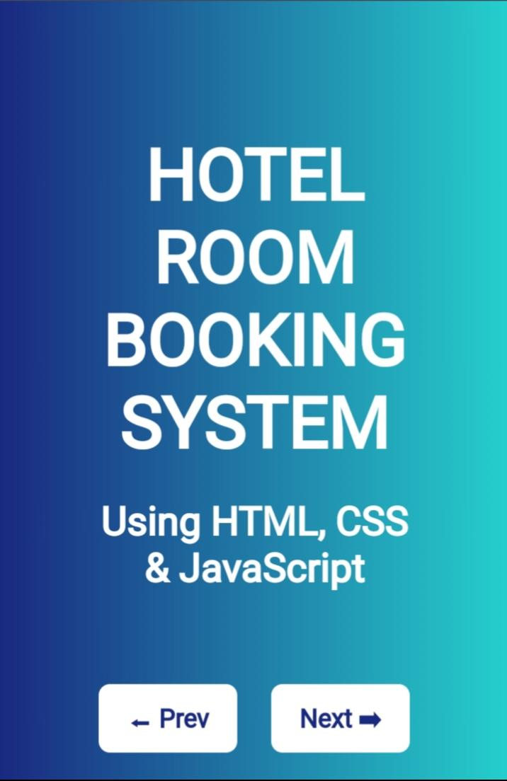
RESULTS AND SCREENSHOTS
3/21/2024 Annual Review
‹#›

Slide 11
CONCLUSION
"This project helped me gain confidence in frontend development.
I learned how to combine HTML, CSS, and JavaScript to solve a real-world problem in a simple way.
In the future, I would like to add database connectivity and payment gateway integration to make it more advanced."
https://github.com/arshadalbido1998-lab/Yashar---TNSDC---FWD.git
‹#›

